Slide 1


Eastside Community Heritage
Black History Month 2023
Saluting our Sisters

Slide 2
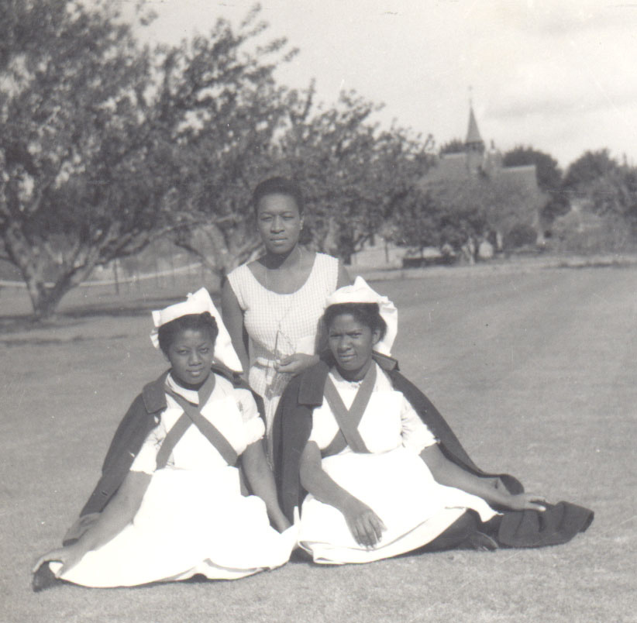
Nurses Cynthia, Joyce and Aletha, St Marys Hospital Kent, 1961

Slide 3
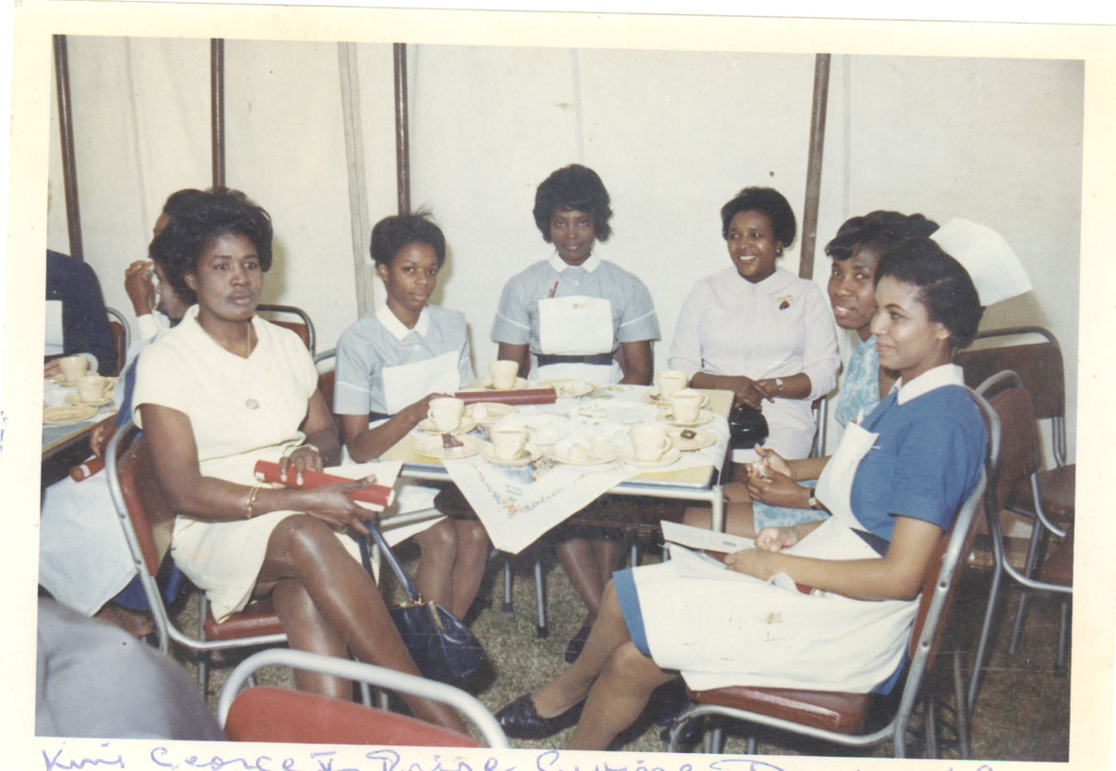
Nurses at King George V’s Hospital, c. 1960s

Slide 4
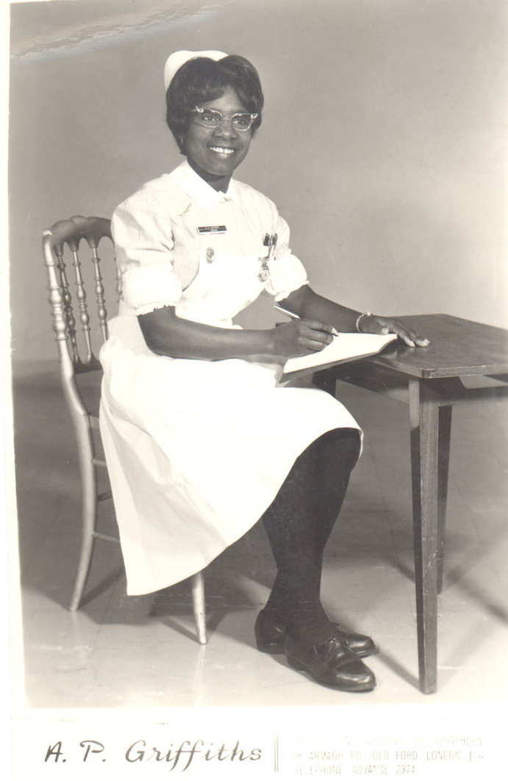
Nurse Griffiths, c 1960s

Slide 5
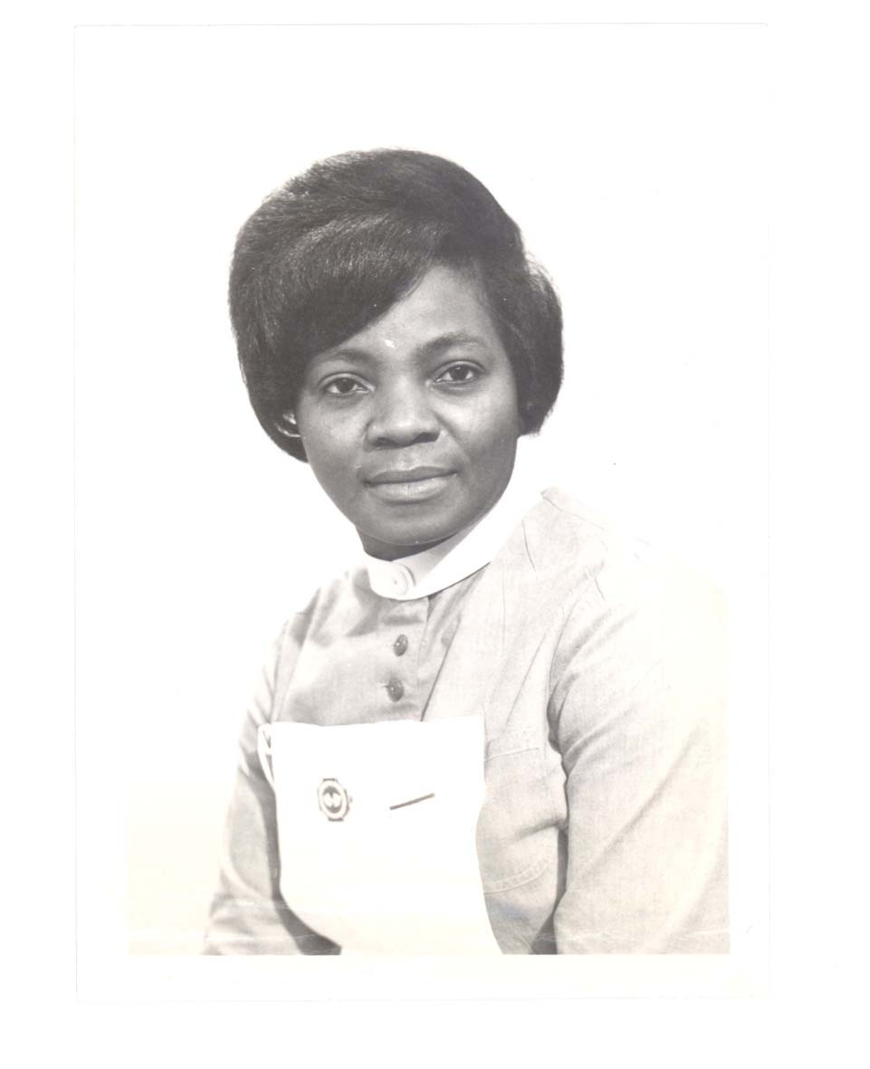
Nurse Verney’s photo ID, 1966, Fever Hospital

Slide 6
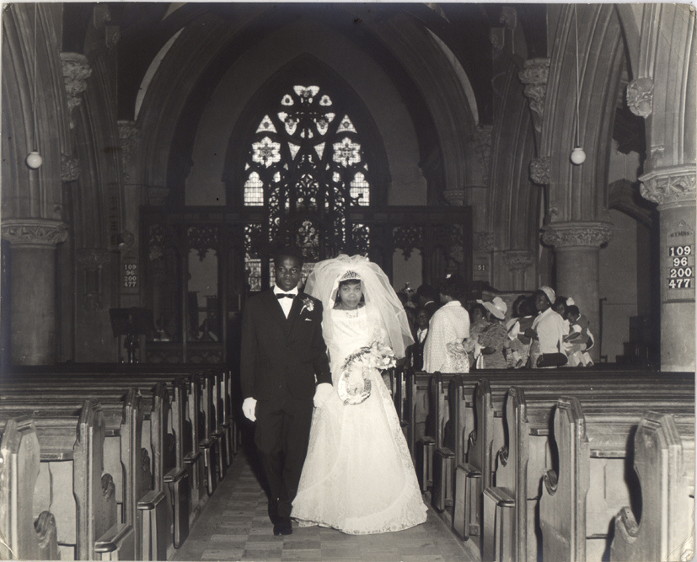
Evelyn and Ciga's wedding (born 1937, wedding c. late 1950s)

Slide 7
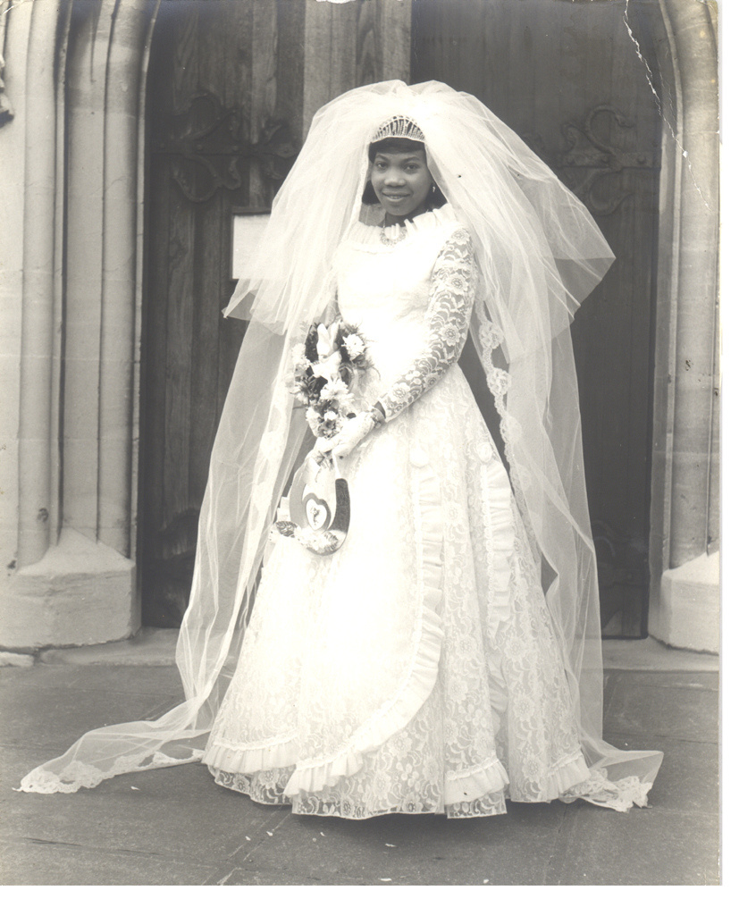
Evelyn and Ciga's wedding (born 1937, wedding c. late 1950s)

Slide 8
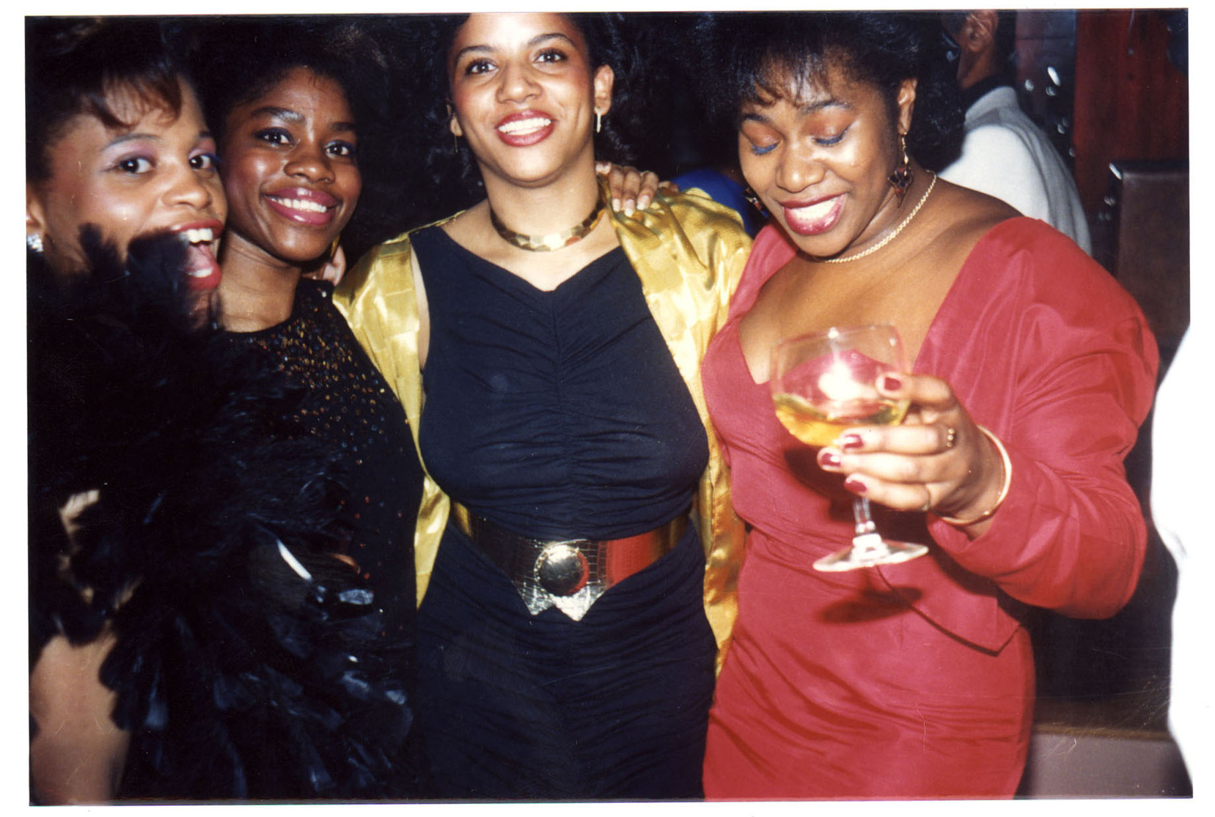
Friends and family at Frank & Gloria's surprise 25th wedding anniversary, 5 June 1988, Forest Gate E7

Slide 9
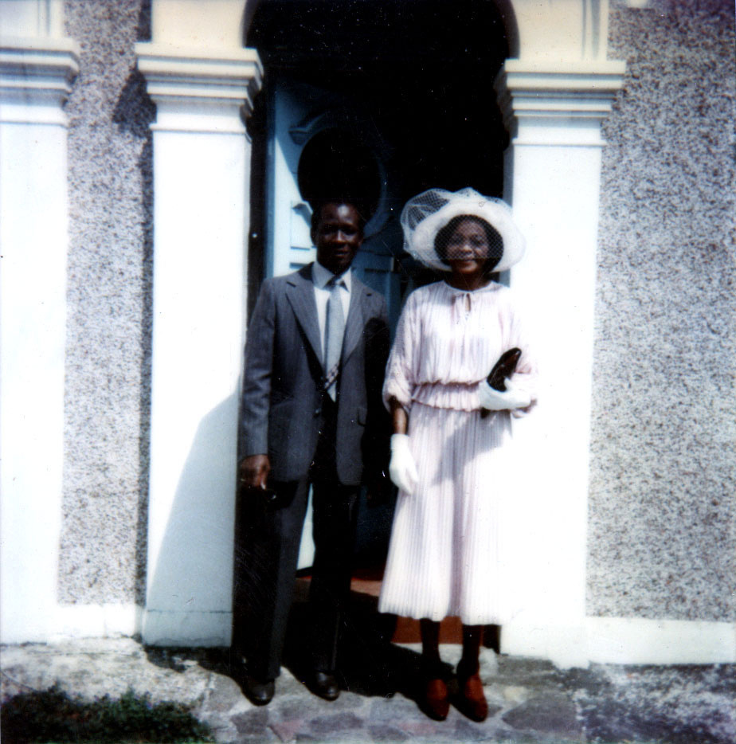
Mr & Mrs. Braithwaite on their way to a Garden Party at Buckingham Palace, 1979

Slide 10
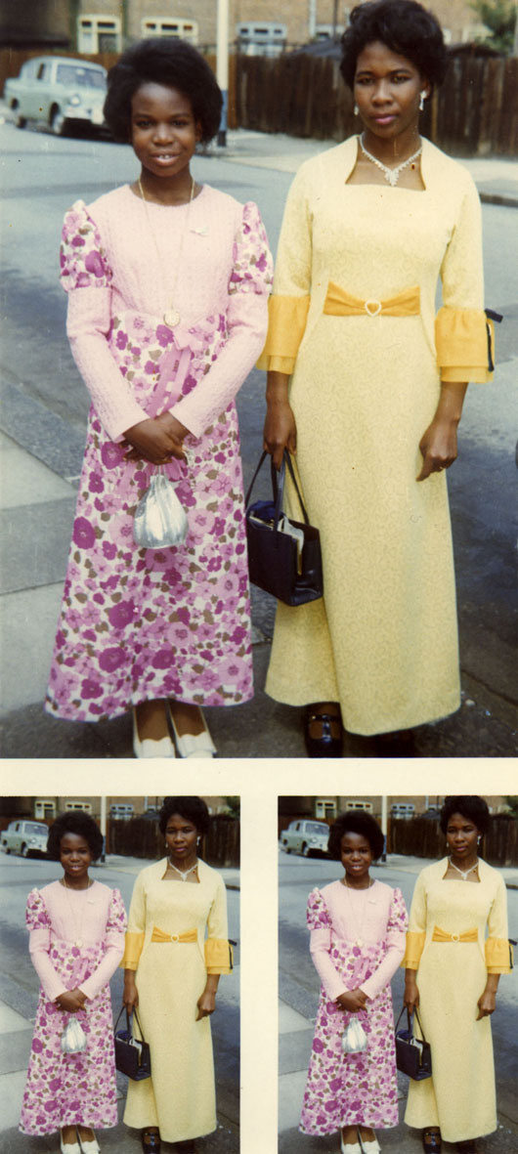
Gloria and her daughter Pamela in dresses made by herself for a friend's wedding in 1972

Slide 11
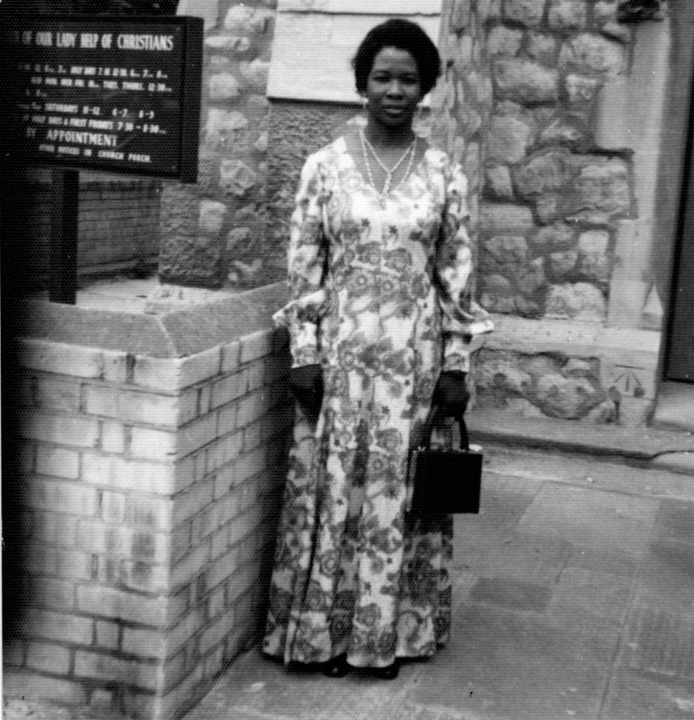
Gloria outside Walthamstow Catholic Church at her husband's cousin's wedding

Slide 12
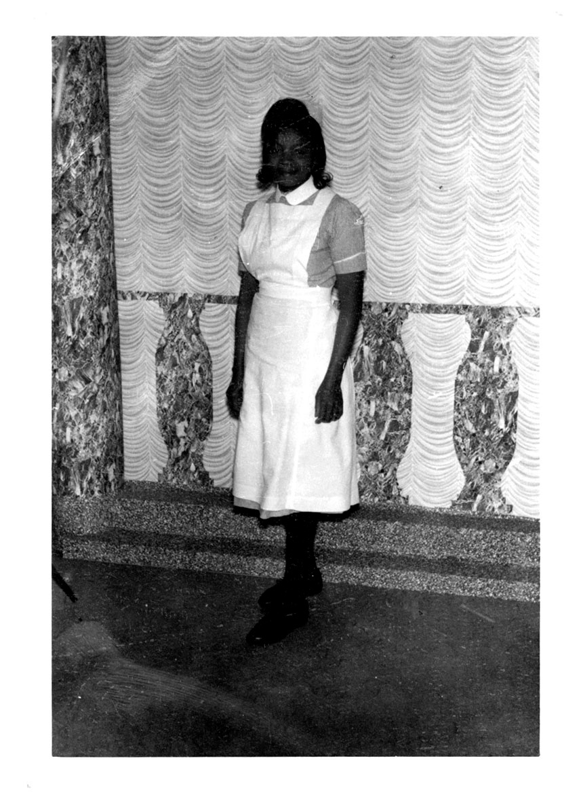
Verney as a student nurse, 1962

Slide 13
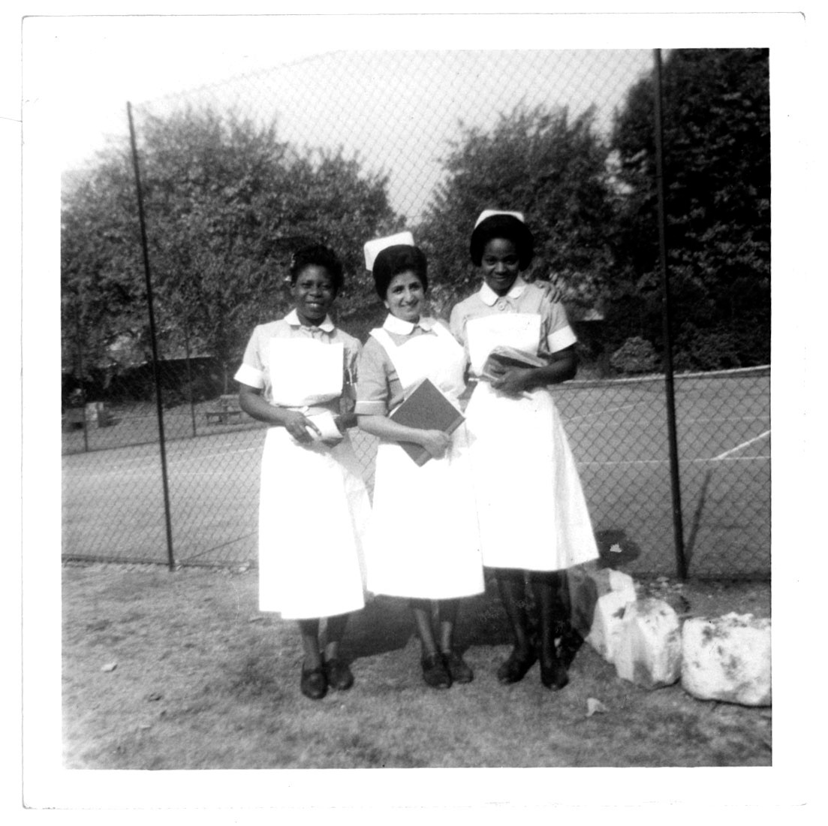
Verney, Alma and Miss Singh; all student nurses at the London Chest Hospital, 1965

Slide 14
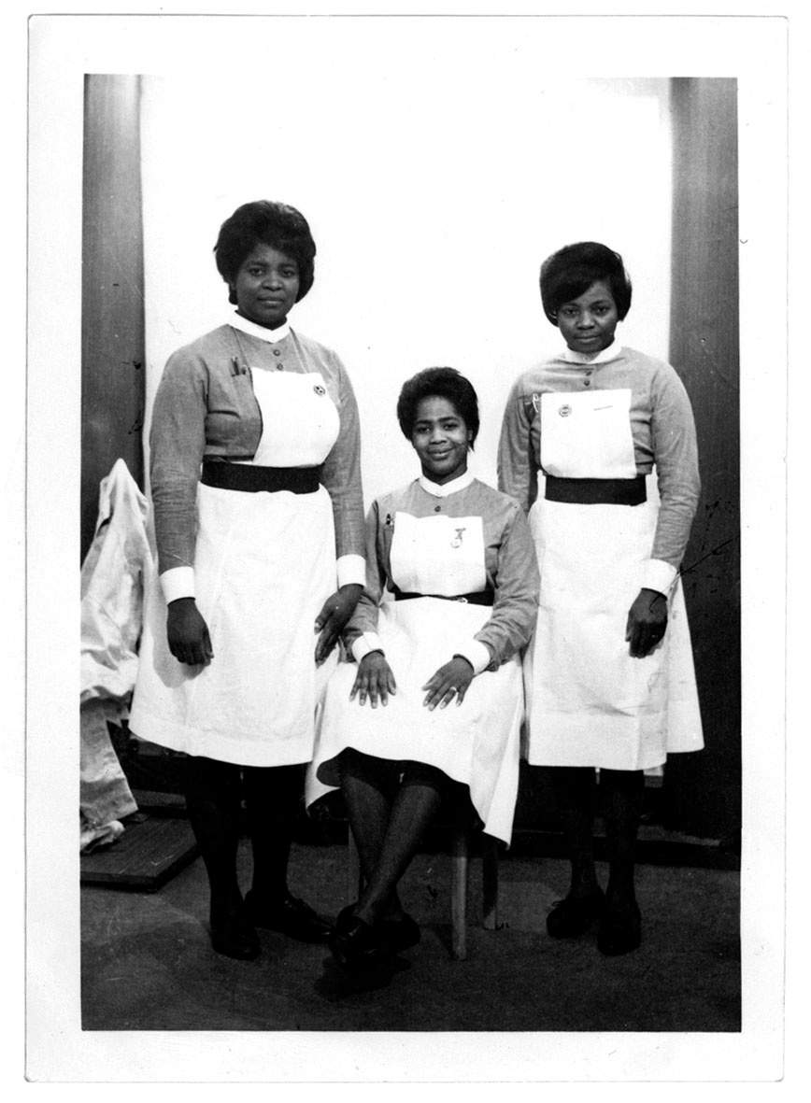
Verney and nursing colleagues Jocelyn and Alice, 1966

Slide 15
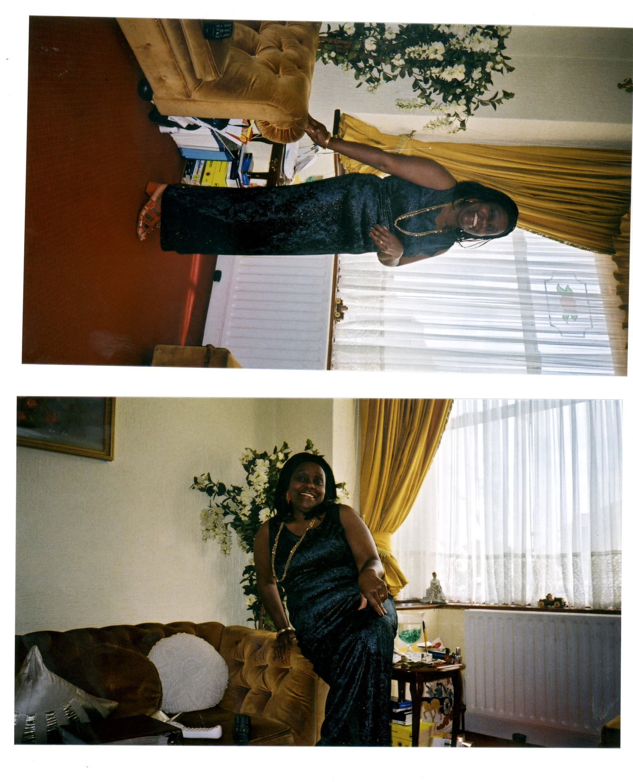
Gloria Prospere in the dress she wore on Millennium eve, 2000

Slide 16
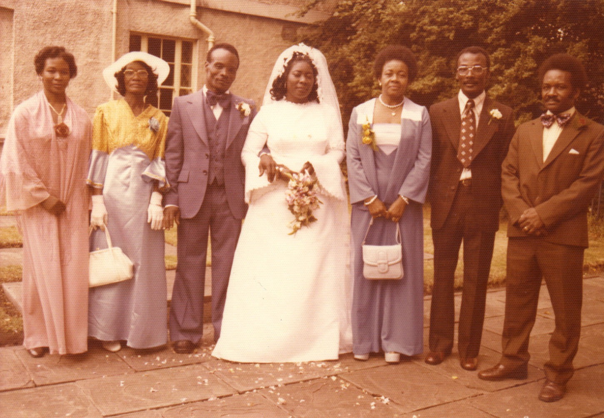
Joyce Byer's wedding,1970s

Slide 17
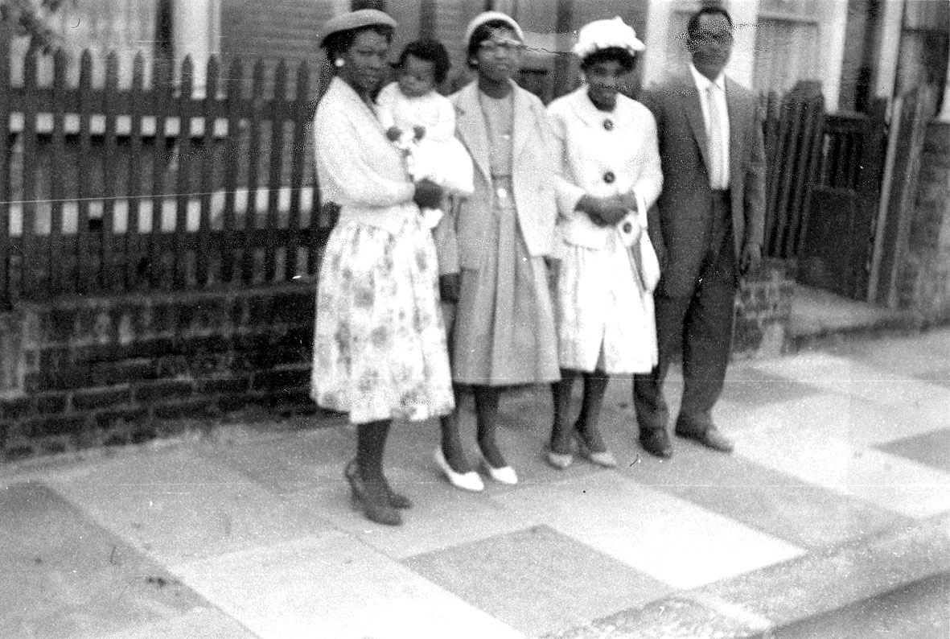
Gloria Byer and friends/family, 1950s

Slide 18
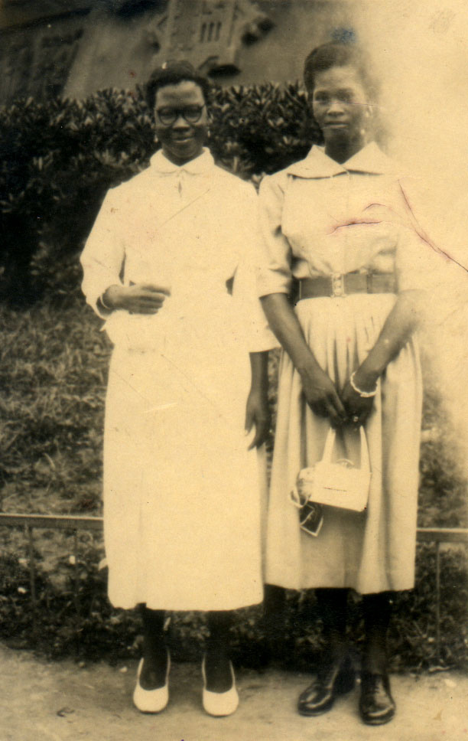
Gloria Byer aged 15 and her friend Clementine Belgrave aged 18 on their way to Britain, 1950s. They had docked in Portugal and were taken ashore by two sailors

Slide 19
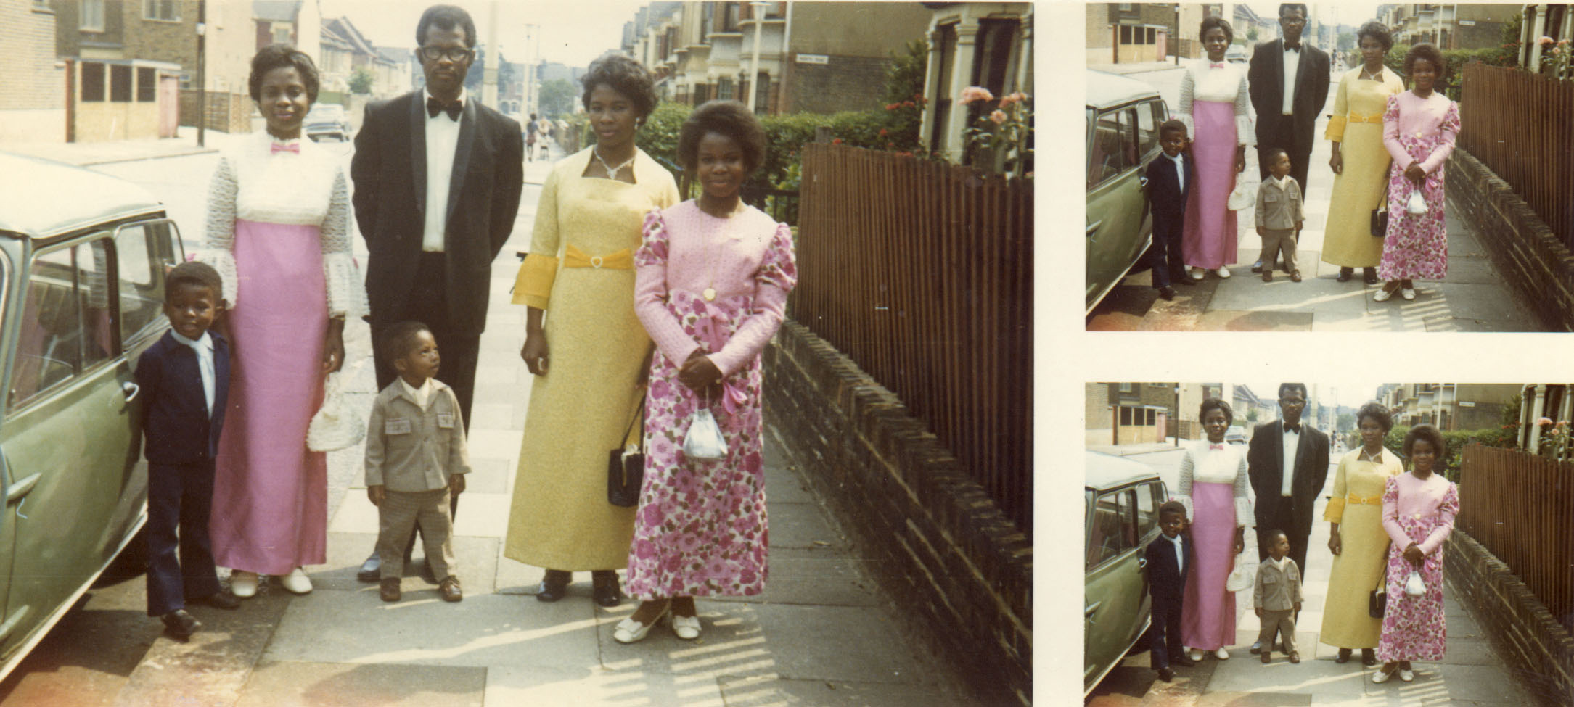
Gloria and her daughter with friends in dresses she made herself for a friend's wedding in 1972

Slide 20
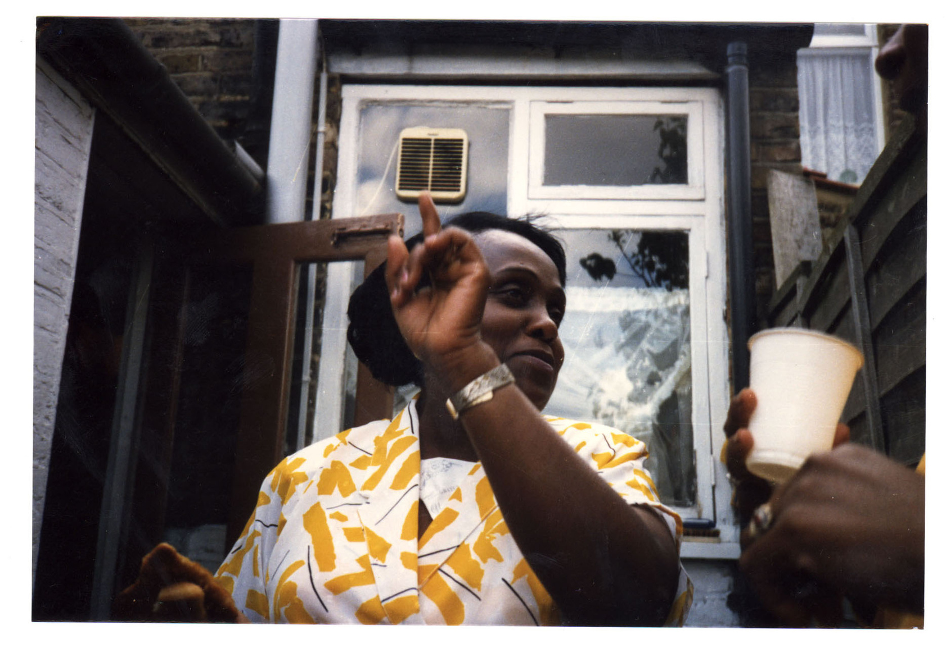
Frank & Gloria's surprise 25th wedding anniversary barbecue on 5 June 1988, Forest Gate

Slide 21
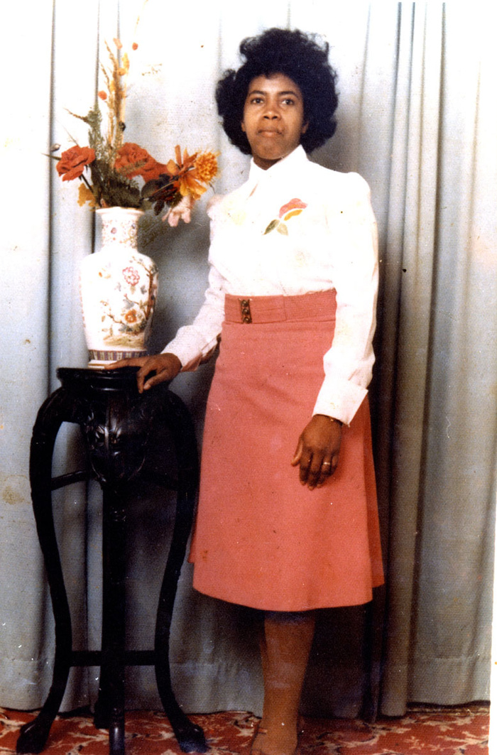
Blanche, Redbridge, 1970s

Slide 22
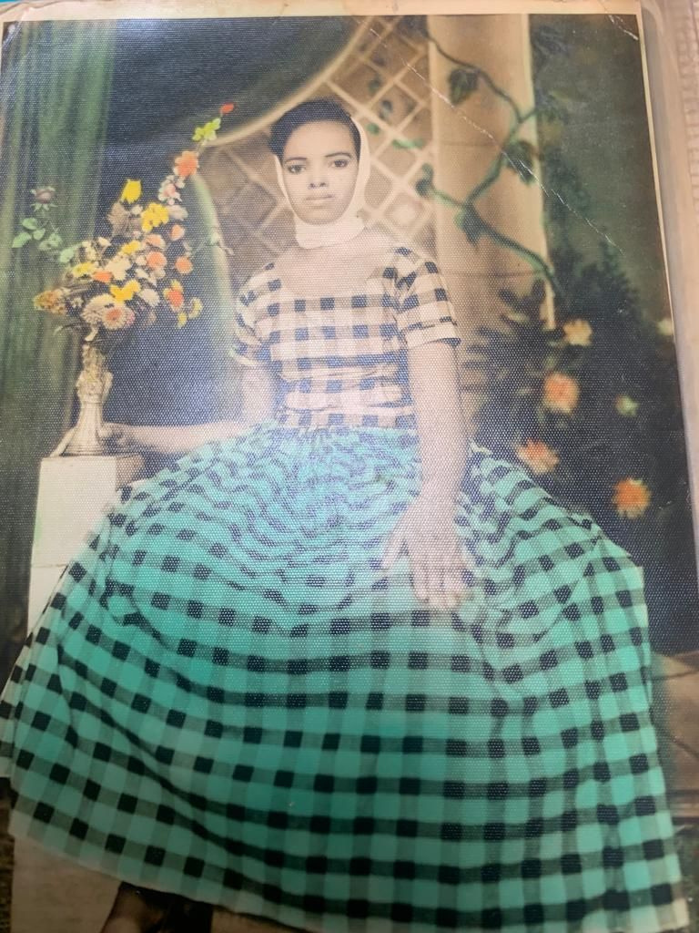
Photo donated by Somali Senior Citizen’s Club

Slide 23
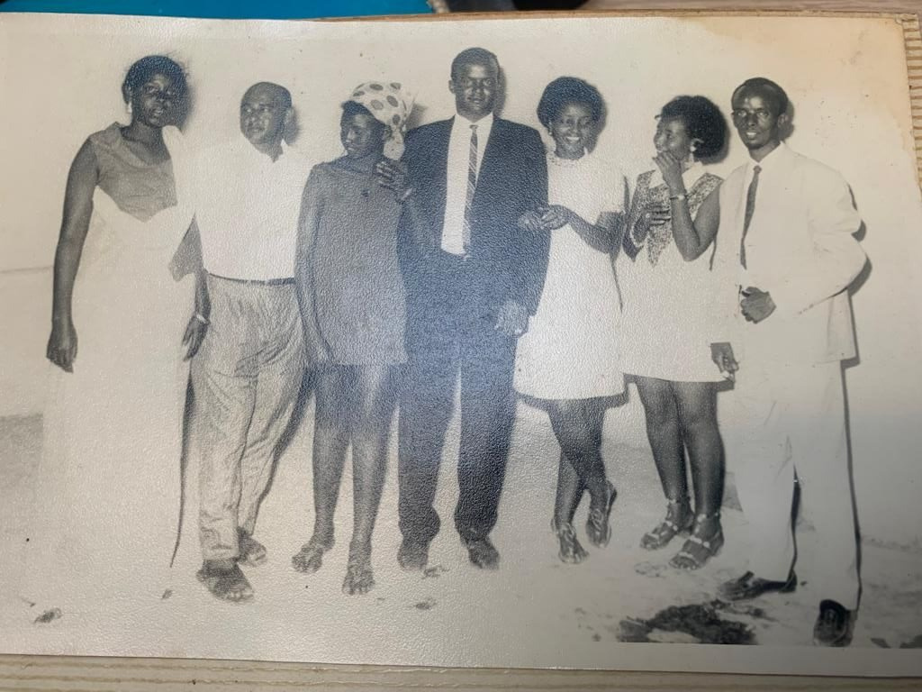
Photo donated by Somali Senior Citizen’s Club

Slide 24
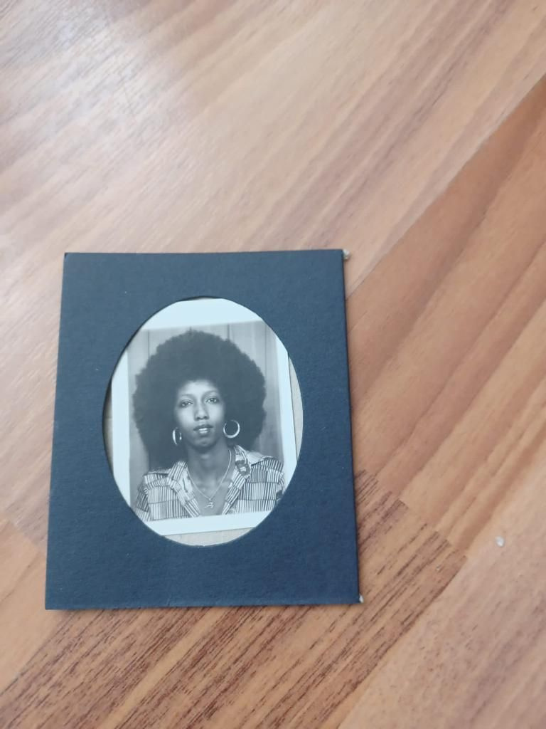
Photo donated by Somali Senior Citizen’s Club

Slide 25
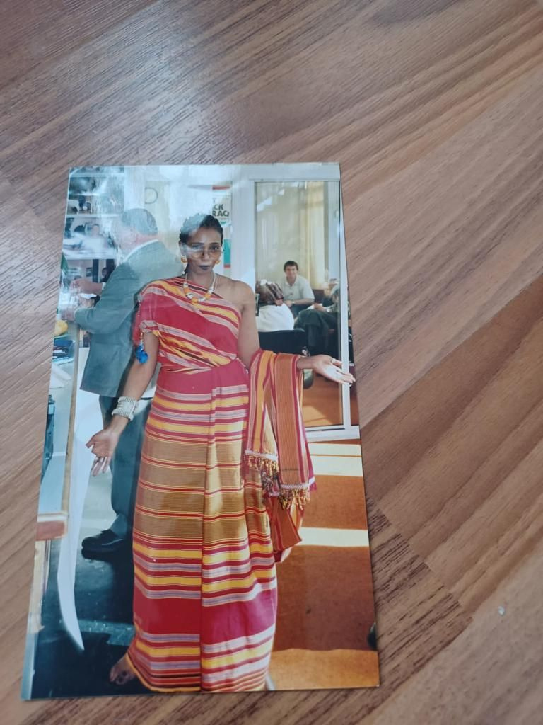
Photo donated by Somali Senior Citizen’s Club

Slide 26
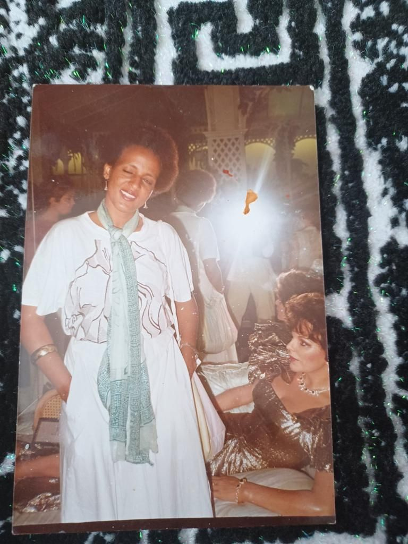
Photo donated by Somali Senior Citizen’s Club

Slide 27
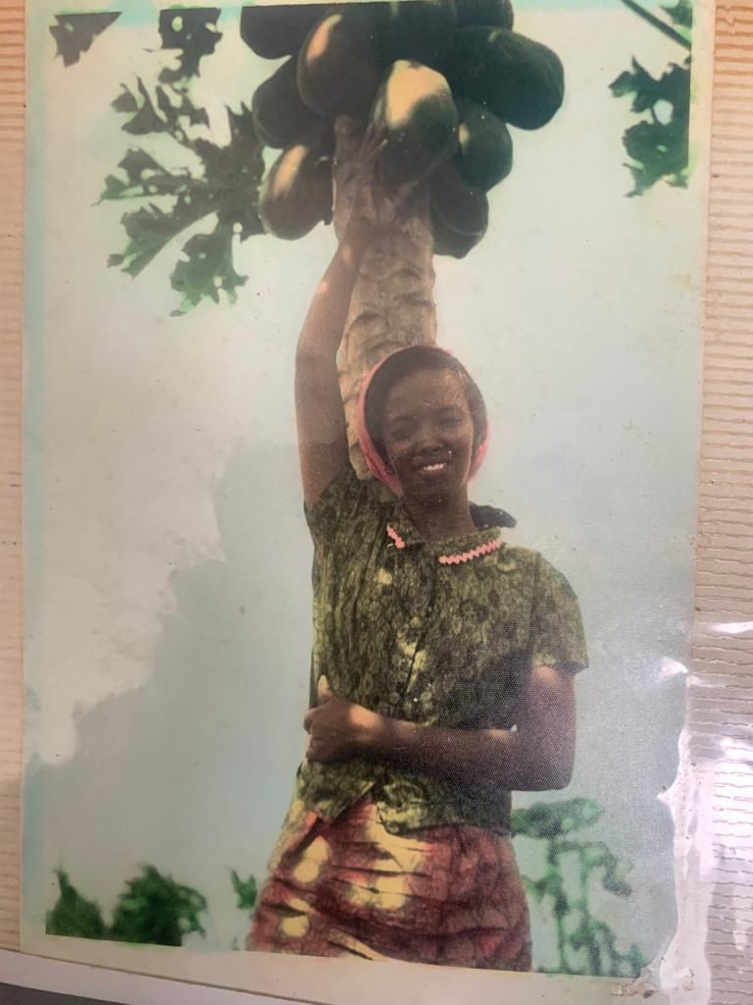
Photo donated by Somali Senior Citizen’s Club

Slide 28
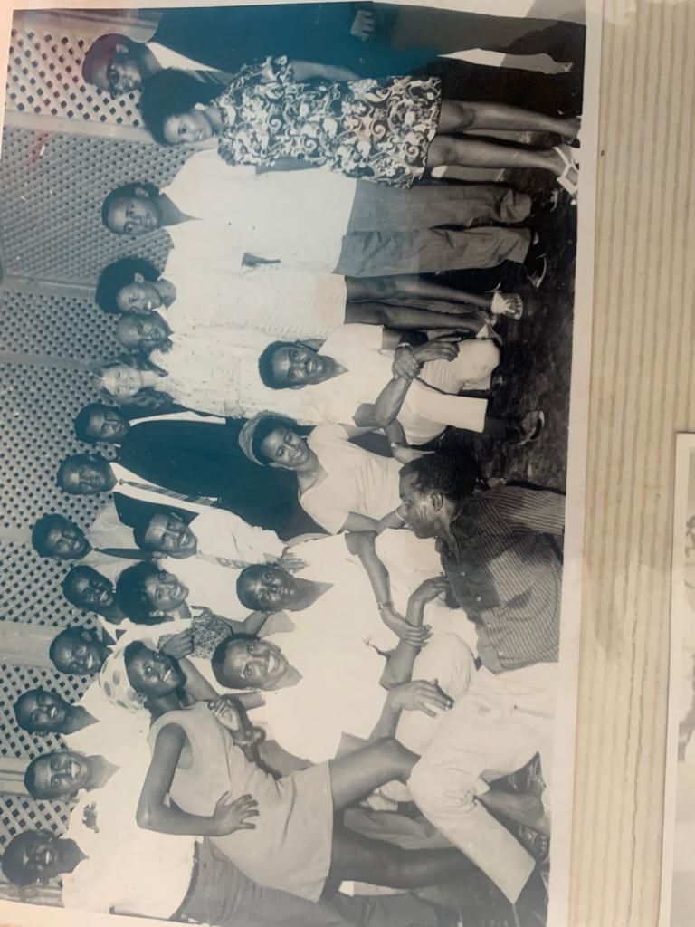
Photo donated by Somali Senior Citizen’s Club

